Slide 1

THEORY OF CONSUMER CHOICE
B.Tech
Second Semester
2018

Slide 2
Y
25
c
20
f
15
e
a
10
d
b
0
15
25
30
X

Slide 3
Assumptions
Individuals can rank their preferences
Non-satiation - people prefer more to less
Transitivity - rankings are consistent
Individuals are willing to give up successfully smaller amounts of one good in order to get additional units of other goods

Slide 4
Bundles of Pizzas and Burgers a consumer might consume
Indifference Curve
Y
25
c
Individuals can rank their preferences
Non-satiation - people prefer more to less
Transitivity - rankings are consistent
Individuals are willing to give up successfully smaller amounts of one good in order to get additional units of other goods
20
f
15
e
a
10
d
I
b
0
15
25
30
X

Slide 5
Indifference Curve: Preference Map
Y
c
25
Indifference curve on the right means greater satisfaction
20
f
e
I
2
15
d
1
10
I
I
0
0
15
25
30
X

Slide 6
Impossible Indifference Curves
Y
Crossing
Violation of Transitivity
e
b
I
1
a
I
0
X

Slide 7
Impossible Indifference Curves
Y
Upward Sloping
b
a
I
X

Slide 8
Impossible Indifference Curves
Y
Thick
No two points can have same satisfaction level
b
a
I
X

Slide 9
Properties of Indifference Curves
Indifference curves (IC) are
    downward sloping
    Convex to the origin
    do not intersect
Higher IC reflect greater level of satisfaction

Slide 10
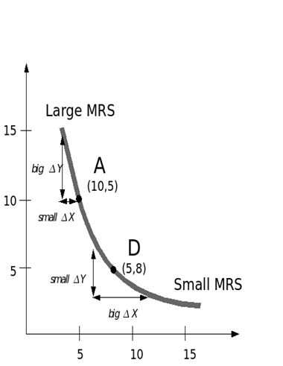
Marginal Rate of Substitution
Slope of IC is called Marginal Rate of Substitution.
It denotes rate at which an individual is willing to trade two goods/ services
U=f(x,y)
dU = (dU/ dx) * dx + (dU/ dy) *dy =0
(dU/ dx) * dx = - (dU/ dy) *dy
dU/ dx
dy
-
=
MUx
MRS
=
=
-
dx
(du/ dy)
MUy

Slide 11
The Basis of Choice: Utility
Utility – the satisfaction derived from a product or service in consumption
Marginal Utility – the extra utility, derived from an extra unit of the good in consumption (MU)
TU derived from n units of the good in consumption = MU₁ + MU₂ + … + MU_{n}
Units of the good
1
2
3
4
Total Utility
TU
6
15
18
11
Marginal Utility
MU
5
4
3
6

Slide 12
The Law of Diminishing Marginal Utility
For any good or service, the marginal utility of that good or service decreases as the quantity of the good increases

Slide 13
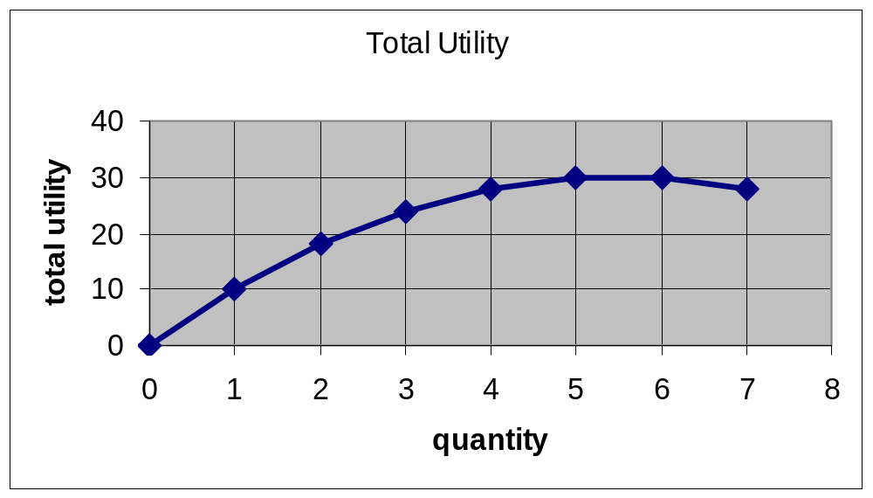
Total and Marginal Utility
Bread
consumed
per meal
Total
Utility
Marginal
Utility
ΔTU
0
1
2
3
4
5
6
7
0
10
18
24
28
30
30
28

Slide 14
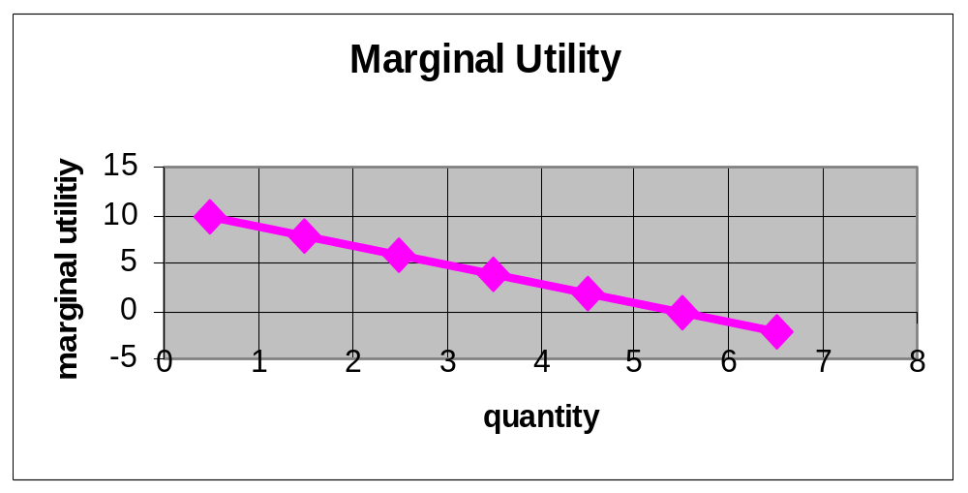
Total and Marginal Utility
Breads
consumed
per meal
Total
Utility
Marginal
Utility
ΔTU
0
1
2
3
4
5
6
7
0
10
18
24
28
30
30
28
10
8

Slide 15
Total and Marginal Utility
Breads
consumed
per meal
Total
Utility
Marginal
Utility
DTU
0
1
2
3
4
5
6
7
0
10
18
24
28
30
30
28
10
8
6
4
2
0
-2

Slide 16
Budget Constraint
Y
=
a
25
M
/
p
y
b
20
L
1
(
p
x
= $1, P_{y}= $2,
M
= $50)
c
10
Opportunity set
d
0
10
30
50
=
M
/
p
x

Slide 17

BUDGET LINE
M PxQ_{x} + P_{y}Q_{y}
Qx = M/Px - Py/P_{x}*Q_{y}
Qy = M/Py - Px/P_{y}*Q_{x}
Slope = - Px/Py

Slide 18
Changes in the Budget Constraint
Price of X Doubles
25
25
L
1
(
p
= $1)
x
L
1
(
p
= $1)
x
Loss
L
2
(
p
= $2)
x
0
50
0
25
50

Slide 19
Changes in the Budget Constraint
Income Doubles
50
L
3
(
M
=
$100)
25
25
Gain
L
1
(
M
=
$50)
L
1
(
M
=
$50)
0
50
0
50
100

Slide 20
Consumer Equilibrium
Consumer Equilibrium is attained when maximum satisfaction is obtained from given choices-
  Utility Maximization

Slide 21
Utility Maximization
Budget line
g
25
c
20
B
10
d
a
A
1
I
0
10
30
50

Slide 22
Utility Maximization
Budget line
g
25
c
f
20
B
e
10
I
3
d
a
I
2
A
1
I
0
10
30
50

Slide 23
Deriving an
Individual’s Demand Curve
A
12.0
e
3
Price-consumption curve
5.2
I
3
L
3
(
p
= $4)
b
0
58.9
B

Slide 24
Deriving an Individual’s Demand Curve
A
12.0
As Price of B increases from $4 to $6, consumer shifts to lower IC
e
3
Price-consumption curve
5.2
e
2
4.3
I
3
I
2
L
2
(
p
= $6)
L
3
(
p
= $4)
b
b
0
44.5
58.9
B

Slide 25
Deriving an Individual’s Demand Curve
A
12.0
e
3
Price-consumption curve
5.2
e
2
4.3
e
I
3
1
2.8
I
2
L
1
(
p
= $12)
I
1
L
2
(
p
= $6)
L
3
(
p
= $4)
b
b
b
0
26.7
44.5
58.9
B

Slide 26
(a) Indifference Curves and Budget Constraints
Deriving an
Individual’s Demand Curve
A
12.0
e
3
Price-consumption curve
5.2
e
4.3
2
e
1
I
3
2.8
I
2
L
1
(
p
b
= $12)
I
1
L
2
(
p
b
= $6)
L
3
(
p
b
= $4)
0
26.7
44.5
58.9
B
(b) Demand Curve
p
b
, $ per unit
12.0
E
1
6.0
E
2
4.0
E
3
0
26.7
44.5
58.9
B

Slide 27
(a) Indifference Curves and Budget Constraints
A
Deriving an
Individual’s Demand Curve
12.0
e
3
Price-consumption curve
5.2
e
4.3
2
e
1
I
3
2.8
I
2
L
1
(
p
b
= $12)
I
1
L
2
(
p
b
= $6)
L
3
(
p
b
= $4)
0
26.7
44.5
58.9
B
(b) Demand Curve
b
p
, $ per unit
12.0
E
1
6.0
E
2
, Demand for B
E
D
4.0
3
1
0
26.7
44.5
58.9
B

